Slide 1
The Energy Generation Market – It’s the End of the World as We Know It (And I Feel Fine)
Todd Williams, ScottMadden
Presentation to EUCI

Slide 2


Slide 3
Agenda
  Energy Sector – The View from Wall Street
  Stressing the System – Baseload Retirements
  The New Normal – Renewables and Gas
  Summary
  Questions

Slide 4
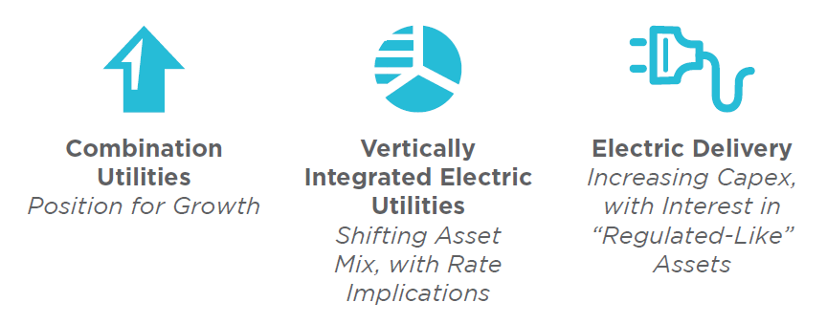

Energy Sector: The View from Wall Street
Companies seek to put capital to work with a focus on improving earnings in a challenging environment. Each sector is positioned differently, but there are common themes.
Sector Investment Themes
Cross-cutting Themes
  Increasing capital spending and allocating capital between projects and sectors
  Making strategic moves and pursuing opportunities for growth
  Cutting costs and raising cash
  Preparing for rate cases and regulatory activity

Slide 5
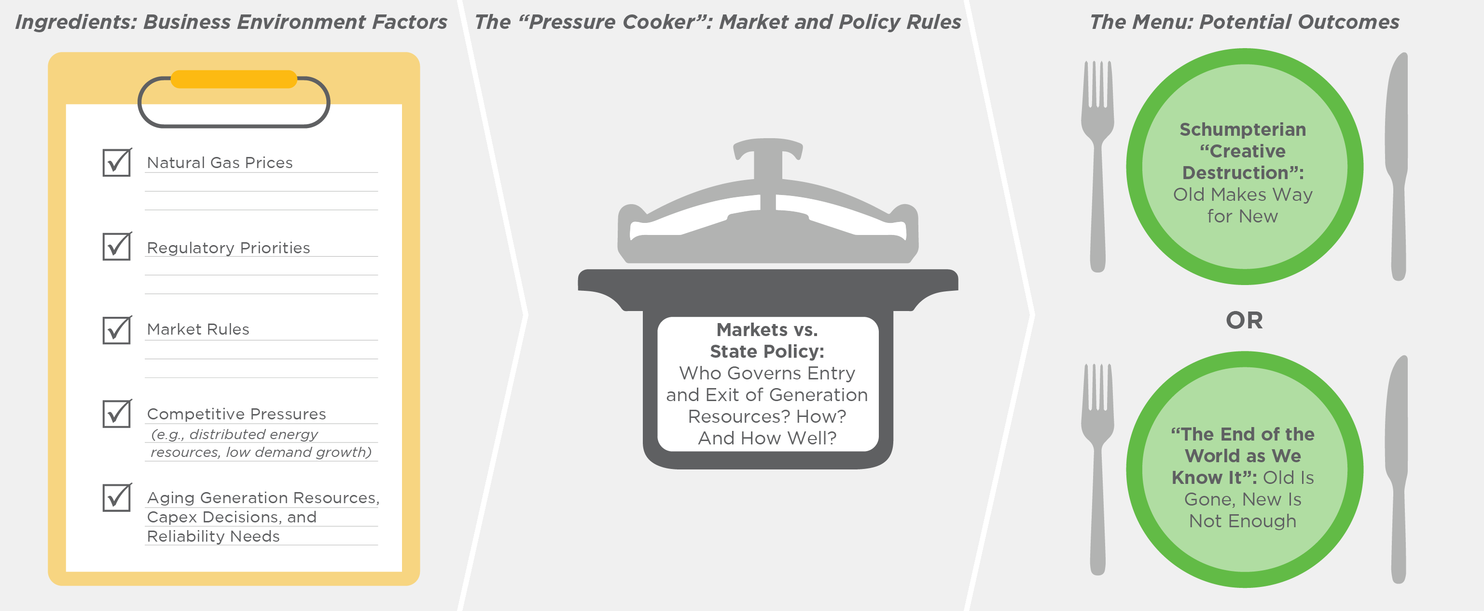
Stressing the System: Baseload Retirements Accelerate
Creative Destruction – A Sign Markets are Working or Road to Ruin?
  Who decides whether to add or subtract generation? How?
  Open to debate: What, if anything, needs to be done?
Energy Markets “Under Pressure”

Slide 6
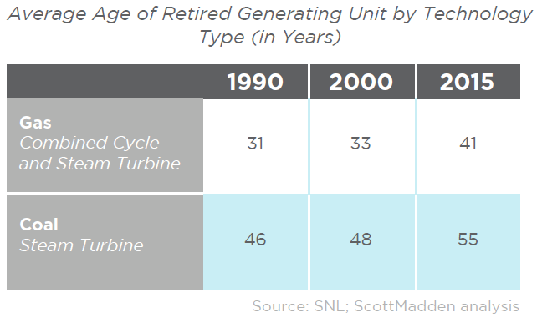
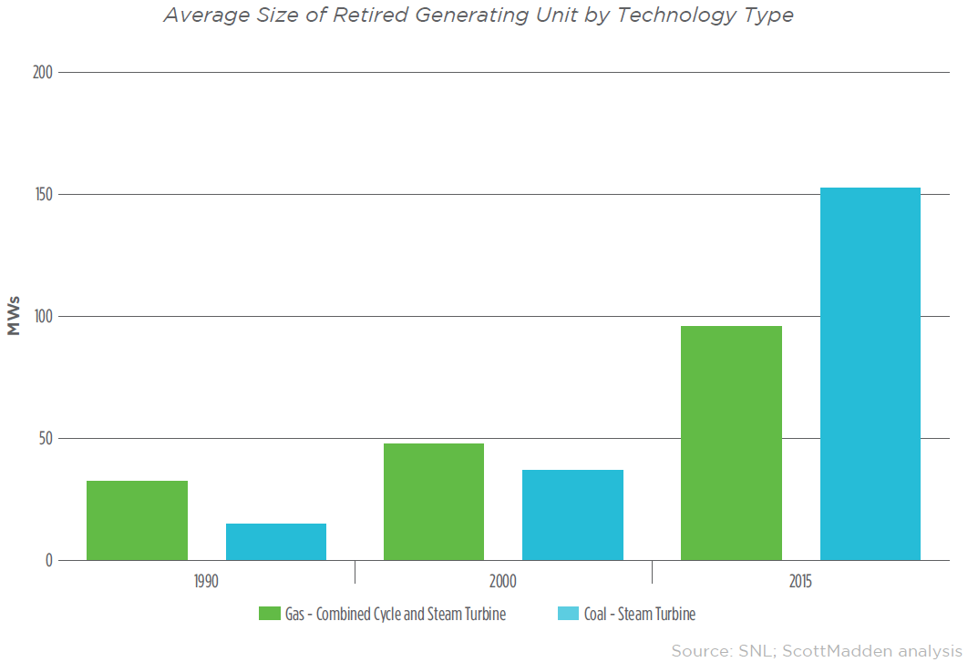
Stressing the System: Baseload Retirements Accelerate (Cont’d)
Average Age of Retired Generating Unit by Technology Type (in Years)
Average Size of Retired Generating Unit by Technology Type
  The average size of retired plants has been increasing, with retired coal plants more than tripling since 2000, while the average size of retired gas steam turbine plants has doubled
  The average age of baseload units at retirement has increased gradually since 1990

Slide 7
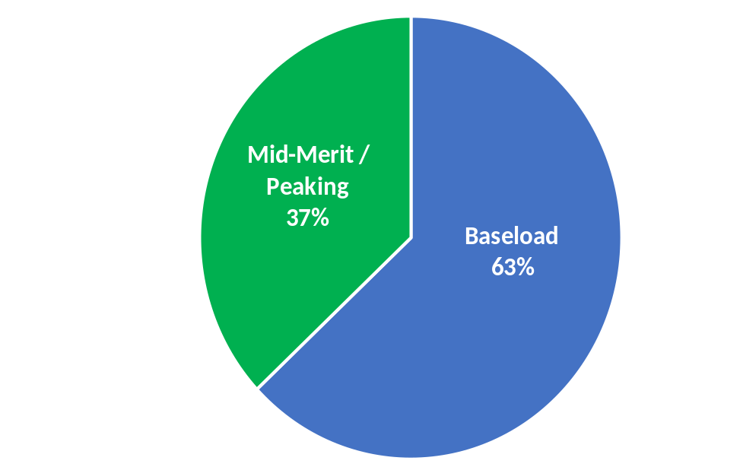
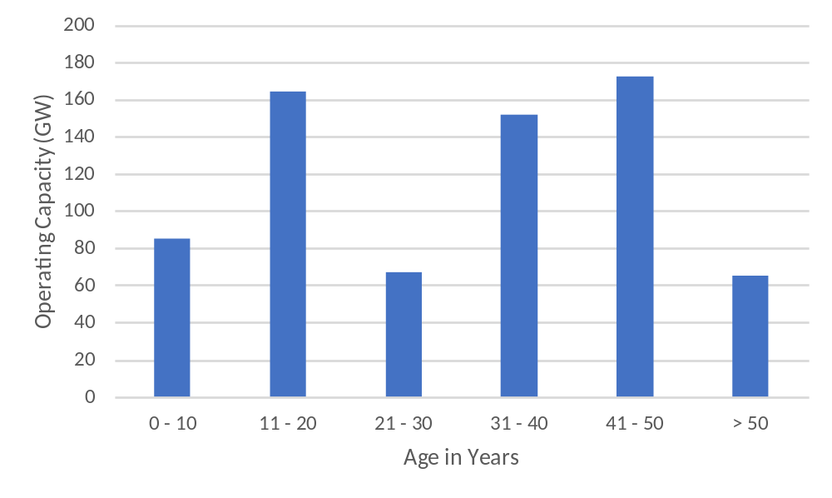
Stressing the System: Baseload Retirements Accelerate (Cont’d)
Current Operating Capacity (GW)
Age of Current Operating Baseload Capacity
  Current operating baseload capacity is approximately 63% of total operating capacity
  Close to a third of current operating baseload capacity is over the age of 40
  Close to 10% of current operating baseload capacity is over the age of 50

Slide 8
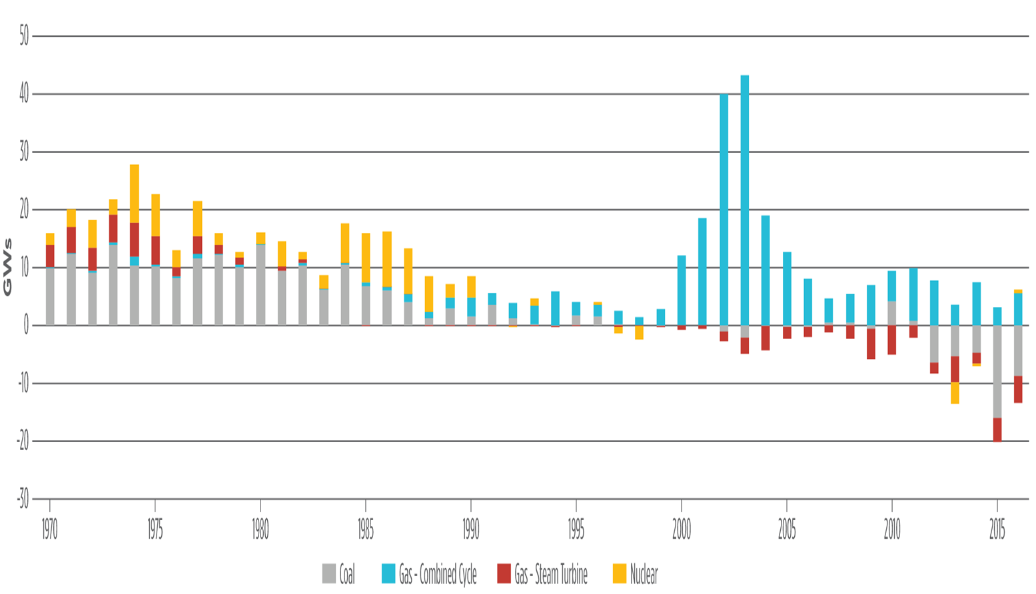
Stressing the System: Baseload Retirements Accelerate (Cont’d)
Net Baseload Additions
Coal
Gas – Combined Cycle
Gas – Steam Turbine
Nuclear

Slide 9
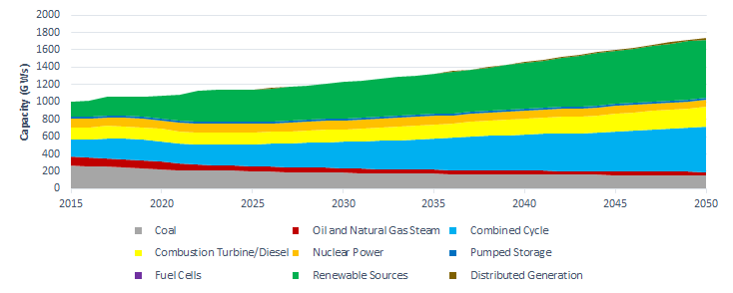
The New Normal: Gas and Renewables
What does the future look like?
  Coal replaced with natural gas, growth in renewables, and new technologies (storage, distributed generation, etc.)
Renewable Sources
Combined Cycle
Coal
Source: EIA, Annual Energy Outlook 2017, Reference Case, Released 01/17

Slide 10
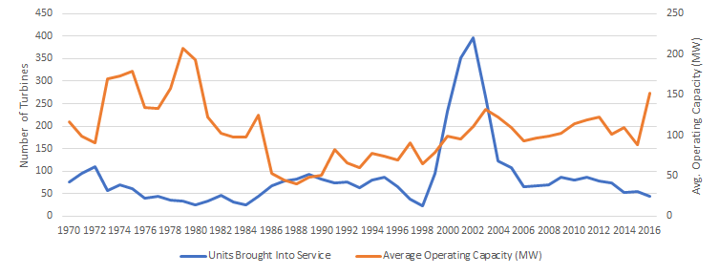
The New Normal: Turbine Sales Return to Historical Levels
  Annual averages
      2006-2016 69 109
      1970-1997 61 106
#
MW

Slide 11
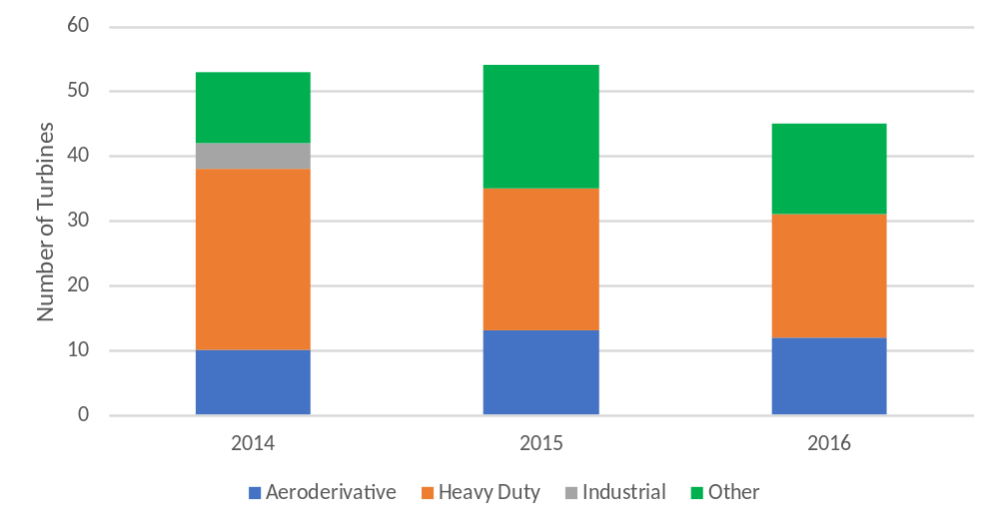
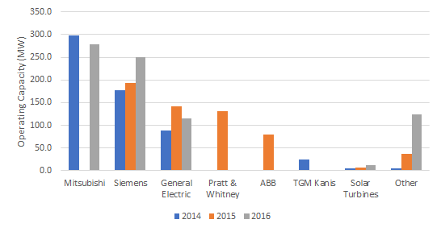
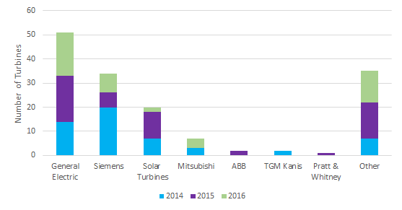
The New Normal: Turbine Sales Return to Historical Levels (Cont’d)
Turbine Sales by Type
  Heavy-duty turbine installations outpaced aeroderivative turbine installations in each of the past three years
  General Electric had the most total turbine installations over the past three years. However, Siemens had the most heavy-duty turbine installations
  Mitsubishi turbine installations had the largest average operating capacity in 2014 and 2016
Turbine Sales by Average Size
Source: SNL, Grid Connected Turbines in the US Only
Turbine Sales by Manufacturer
Source: SNL, Grid Connected Turbines in the US Only
Source: SNL, Grid Connected Turbines in the US Only
Note: Mitsubishi reports 16 gas turbines sold within the US between 2014 and 2016

Slide 12
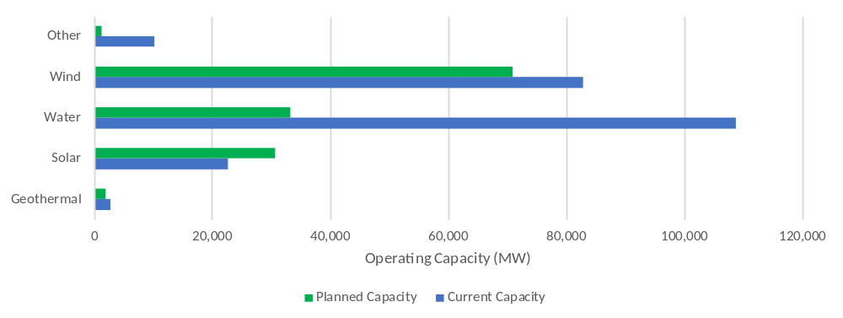
The New Normal: Renewables Are Continuing to Expand
Changing Generation Landscape
  Operating capacity from utility scale renewables will increase approximately 60% by 2027 based on projects currently under development or construction
  An additional 71,000 MW of operating capacity from utility scale renewables has been announced, but development has not begun
  Distributed energy resources (e.g., rooftop solar) are not included in the above chart

Slide 13
The New Normal: Wind Power Generation
Changing Generation Landscape
  Gangbusters growth – 25,819 MW of wind capacity under construction or in advanced development as of the end of the second quarter of 2017, a 41% year-over-year increase
  28% of the installed capacity for the year is contracted to corporate and other non-utility purchasers
  Production tax credit boom bust – phase down from 2017-2019
Source: American Wind Energy Association, Second Quarter 2017 Market Report

Slide 14
The New Normal: Solar Power Generation
Changing Generation Landscape
  On December 18, 2015, the U.S. congress extended the 30% Investment Tax Credit (ITC) for solar through 2021
    +25 GW of extra solar capacity (2016-2020) and $40 billion in incremental investment
  Solar prices will likely continue to decline although at a slower rate
Source: GTM Research, US Solar Market Insight Report 2Q 2017

Slide 15
Summary
  Generation development – “not dead yet”
    Focus on gas, wind, and solar, “the new normal”…until it isn’t
    Gas continues to replace coal
    Despite a political “all of the above” political strategy
  Gas prices continue to stay low – even with exports
  Wholesale markets – zero or near-zero marginal costs continue to hammer coal and nuclear
    State and market issue in valuing capacity
    States losing jobs, markets losing diversity
  Load growth approaching zero (aggregate)
    Peakier peaks
    How will it impact generation installation decisions?

Slide 16
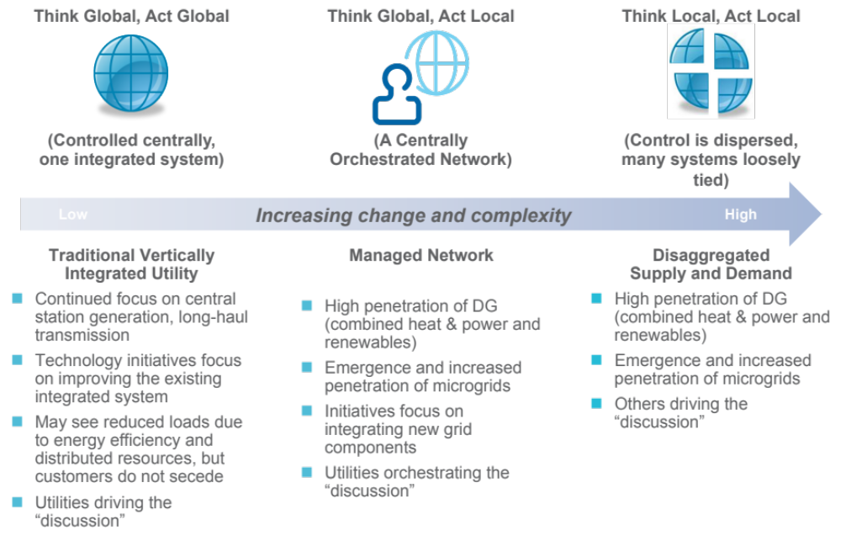
Summary (Cont’d)
The traditional utility business model must evolve.

Slide 17
Summary (Cont’d)
Recommendations
  Plan Strategically
  Use Real Options
  Collaborate
  Don’t Forget the Basics
  Advocate

Slide 18
Fodder

Slide 19
Evolving Grid
Changing Generation Landscape
Major Drivers
  New technologies, evolving resource mix, and market conditions changing energy delivery infrastructure
  Energy efficiency, demand response (DR), and demand-side management programs (DSM) encourage conservation
  Deployment and integration of distributed energy resources (DERs) is a game-changer facilitated by:
    Regulatory policy and incentives
    Technology advancements
    Increased acceptance levels
  Technology forcing the need to manage both sides of the supply/demand equation
Net Metered Customers
+210%
Source: EIA, Form EIA-861, January 2016

Slide 20
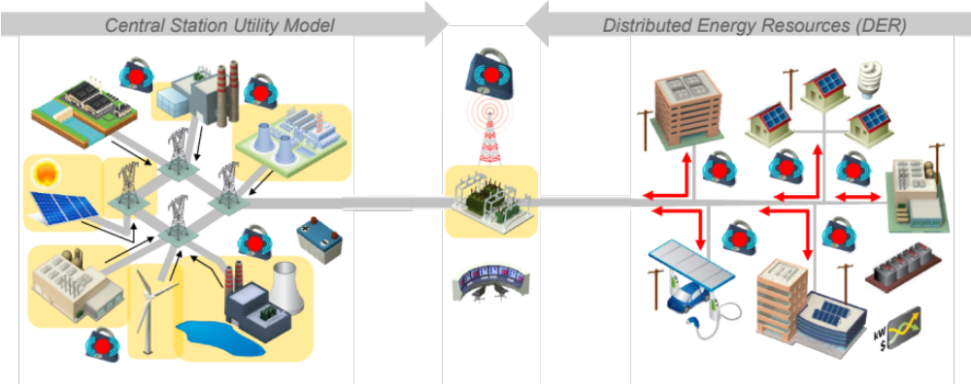
Evolving Grid (Cont’d)
Changing Generation Landscape
Challenges
  Reliance on central station generation being called into question
  Regulatory models need to be reconsidered
    Accommodate new market entrants
    Address stranded investments
  Market operations are no longer one-way, centralized, and fully transparent

Slide 21
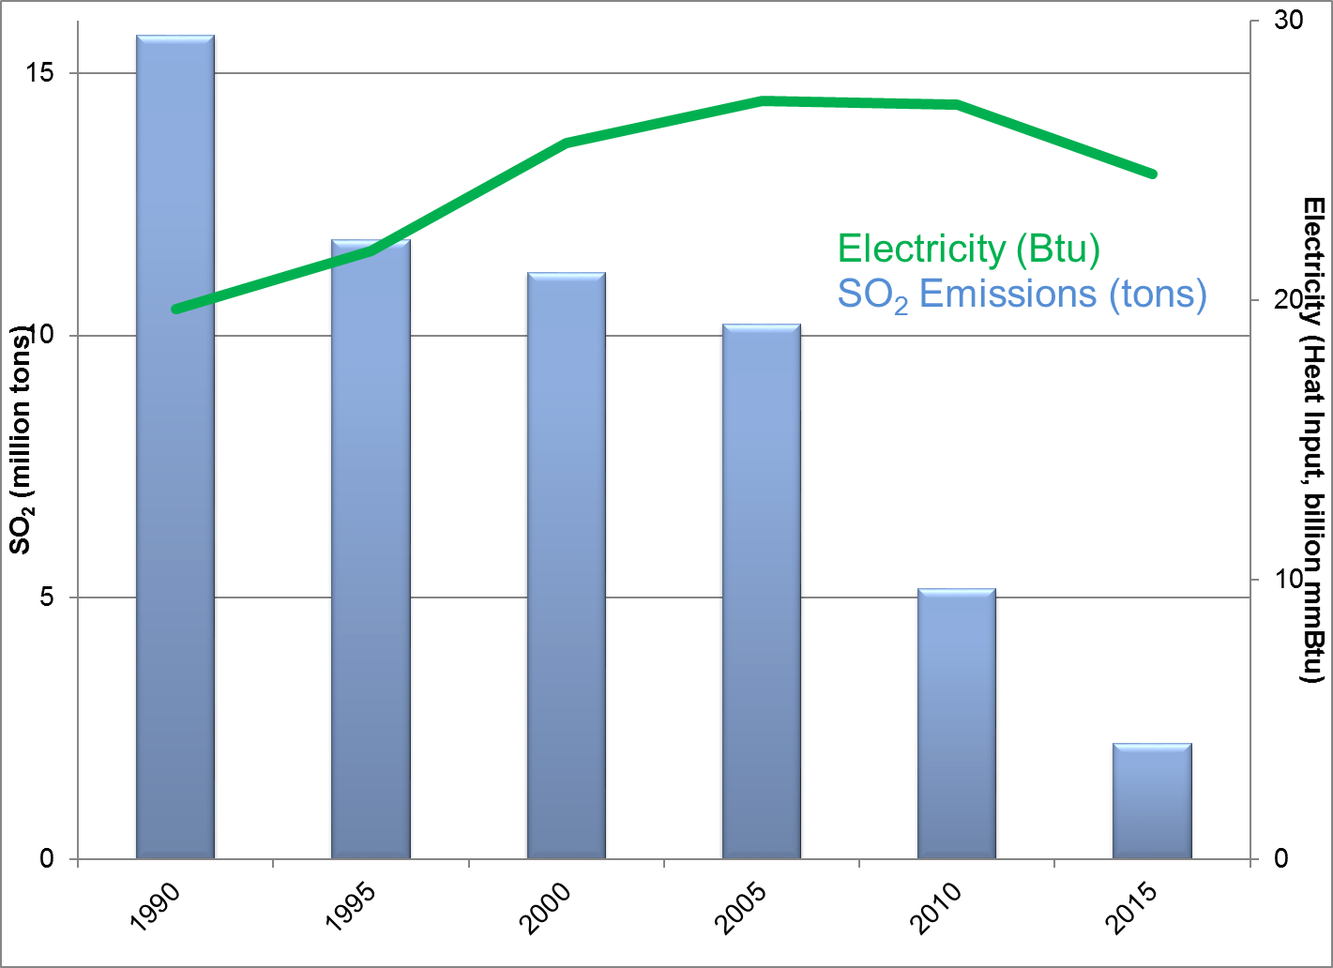
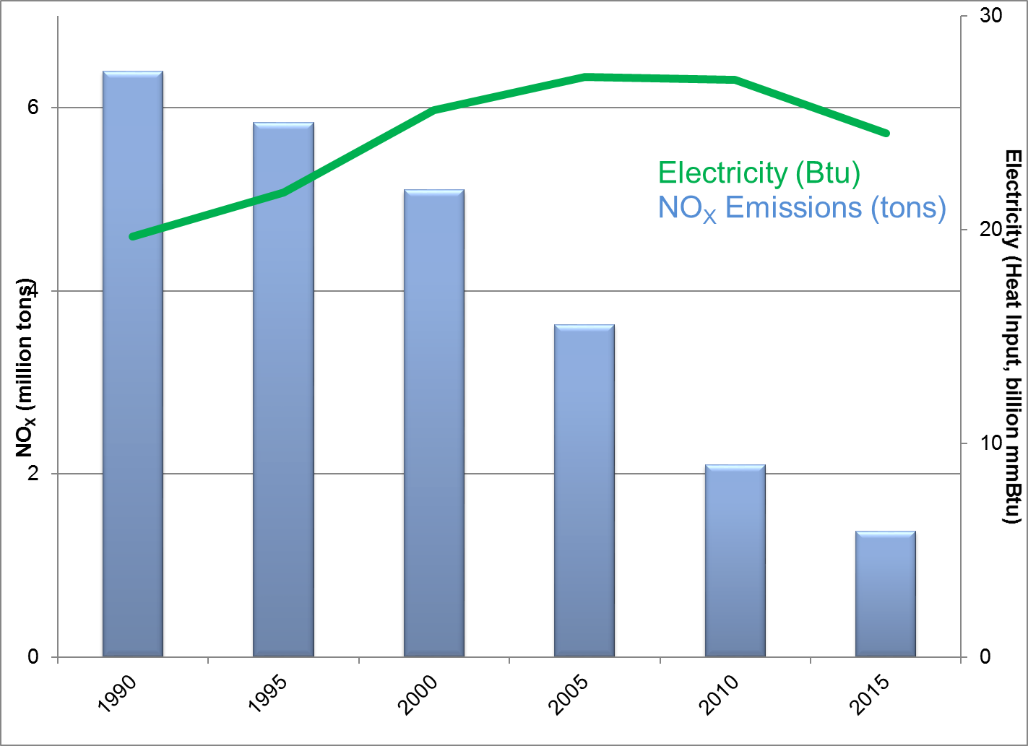
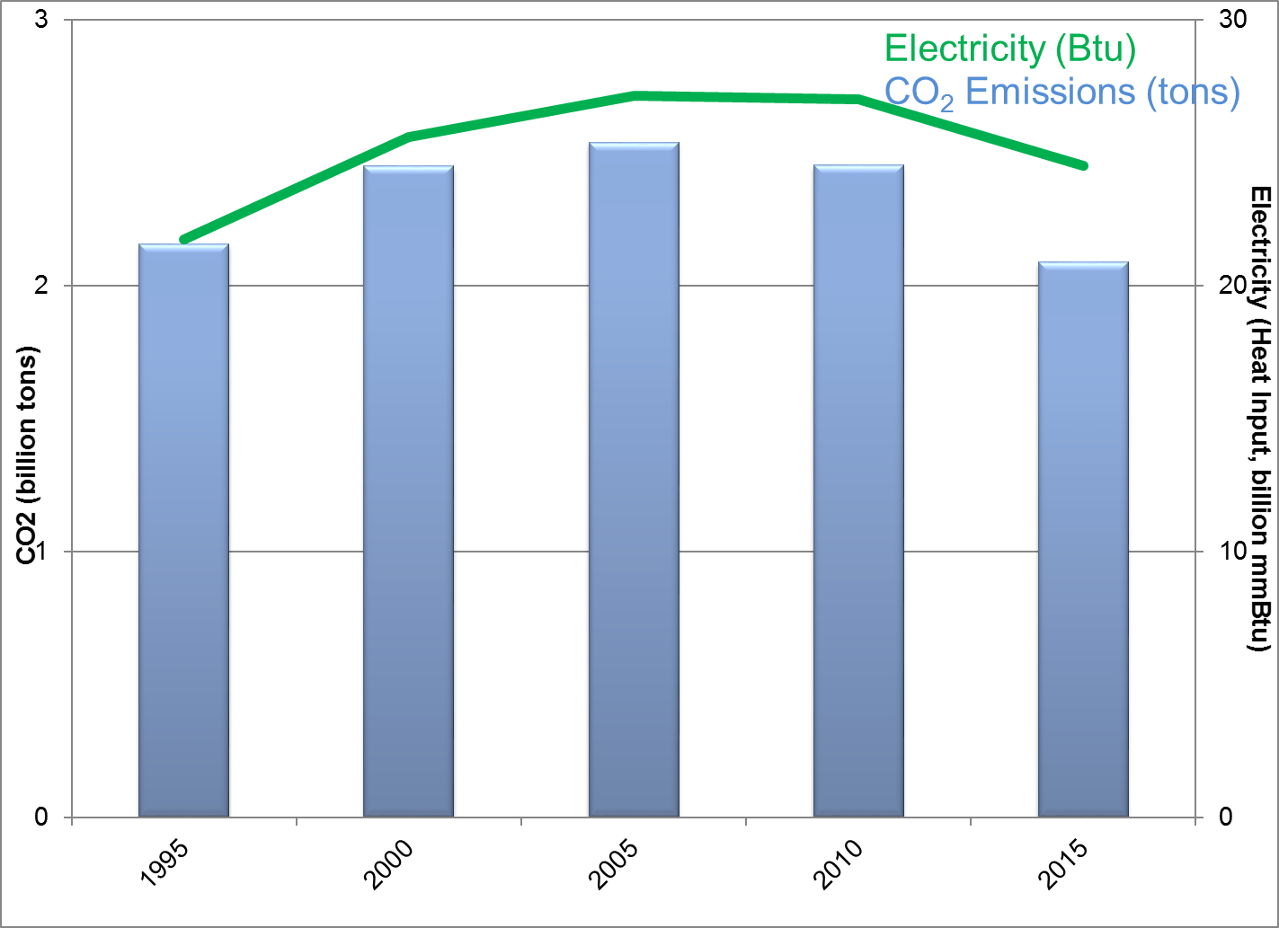
The Grid has become substantially greener in a short time…
Changing Generation Landscape
Total emissions have fallen dramatically since 1990, even while total electricity generation has increased.
SO₂
NO_{x}
CO₂
1990 2015
1990 2015
1990 2015
Source: EPA, https://www3.epa.gov/airmarkets/progress/datatrends/index.html

Slide 22
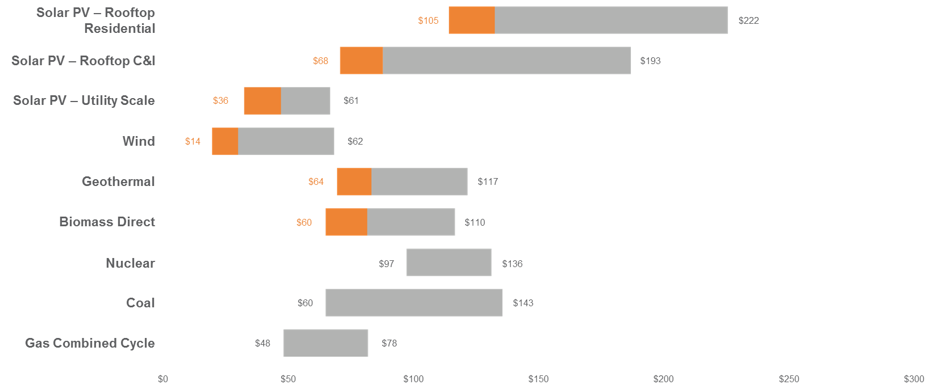
Can Wind and Solar Compete with Conventional Generation?
Changing Generation Landscape
Unsubsidized LCOE
Subsidized LCOE
  What is LCOE?
  The levelized cost of energy (LCOE) is the net present value of the unit-cost of electricity over the lifetime of a generating asset. It is often taken as a proxy for the average price that the generating asset must receive in a market to break even.
In Certain Cases, Solar & Wind Are Competitive with Gas
Source: https://www.lazard.com/perspective/levelized-cost-of-energy-analysis-100

Slide 23
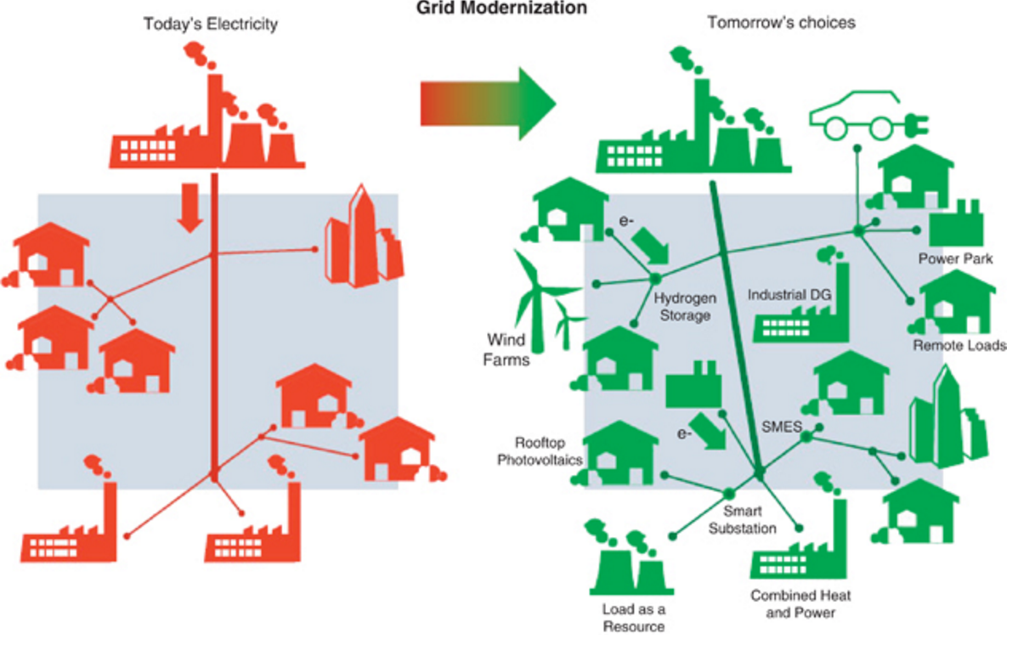
Green Challenges: Consumer choice
Changing Generation Landscape
A little like peaceful atomic power and military atomic power, you really cannot have grid-scale green energy without distributed green energy.
Source: http://www.netanir.ir/upload/image/distributed-generation.jpg

Slide 24
Green Challenges: A darker side of green
Changing Generation Landscape
If the greening of the grid means both utility-scale and distributed generation, then how much is our grid today like the telephone network in the late 1980s?
“Telephone networks, it was often said, had an intelligent core — the switches that ran everything — and “dumb” edges, meaning the handsets in nearly every home and business in the nation.
The Internet, by contrast, would have a “dumb” core — all the network did was carry data — with intelligent ­edges, meaning the individual computers controlled by users.”
Washington Post, A Flaw in the Design, 5/30/2015, http://www.washingtonpost.com/sf/business/2015/05/30/net-of-insecurity-part-1/

